Slide 1
DSA 210 PROJECT
PHASE III
Haşim Büyükçelik 32689

Slide 2

PHASE 3 – ADVANCED ANALYSIS & MODELING
As we moved into Phase 3, the goal shifted from exploratory analysis to predictive modeling and deeper behavioral insights.
This phase combines feature enrichment with machine learning methods to better understand the relationship between testosterone levels and gaming behavior.
🔹 Feature Engineering: New variables like Engagement Score and Genre Category were created to capture gaming intensity and psychological style.
🔹 Hormone-Aware Modeling: Gaming data was linked with testosterone levels to build models that predict hormonal trends based on gaming behavior.
🔹 Applied ML Techniques: We implemented and compared multiple models:
Linear Regression: for baseline predictive insights
Random Forest: to capture non-linear interactions
K-Nearest Neighbors (KNN): for behavior pattern matching
🔹 Model Evaluation: Performance was assessed using MAE, R², and cross-validation, identifying which features most contribute to predicting testosterone levels.

Slide 3
📊 Application of Machine Learning Methods
To explore how gaming behavior can predict or reflect testosterone levels, several supervised machine learning models were applied.
Each model helped identify patterns linking gaming features to hormonal indicators, using both regression and classification approaches.
Linear Regression Used to predict testosterone levels based on features like Engagement Score, Game Genre, and Playtime. Provided a baseline model for comparison.
Random Forest Captured non-linear interactions between gaming behavior and testosterone. Also used to extract feature importance scores.
K-Nearest Neighbors (KNN) Classified users into High or Low Testosterone groups based on gaming similarity. Helped visualize proximity-based behavioral clusters.
XGBoost Used for testing advanced tree-based performance on testosterone prediction. 🔍 Goal: To assess whether digital behavior patterns can accurately reflect hormonal profiles, and to compare models based on MAE, R², and classification accuracy.

Slide 4
Feature Enrichment for Modeling
In Phase 3, several engineered features were introduced to better represent user behavior and enhance model performance.
These enriched features allowed machine learning models to make more accurate predictions about testosterone levels based on gaming activity.
Dataset Merging by Age and Gender
Combined hormonal and gaming data to allow aligned behavioral and biological analysis.
🔹 GenreCategory (Game Type Classification)
Categorized games into Casual, Competitive, or Other for clearer psychological segmentation.
🔹 EngagementScore (Custom Intensity Metric)
Calculated using the formula: PlayTimeHours + (SessionsPerWeek × AvgSessionDurationMinutes / 60)
Captures gaming frequency, duration, and consistency in one numeric value.
🔹 Exploratory Visualizations:
Testosterone vs Genre Type
Testosterone vs Game Difficulty
Testosterone vs Engagement Score
These steps formed the foundation for feature-rich machine learning models, linking digital behavior with biological traits.

Slide 5
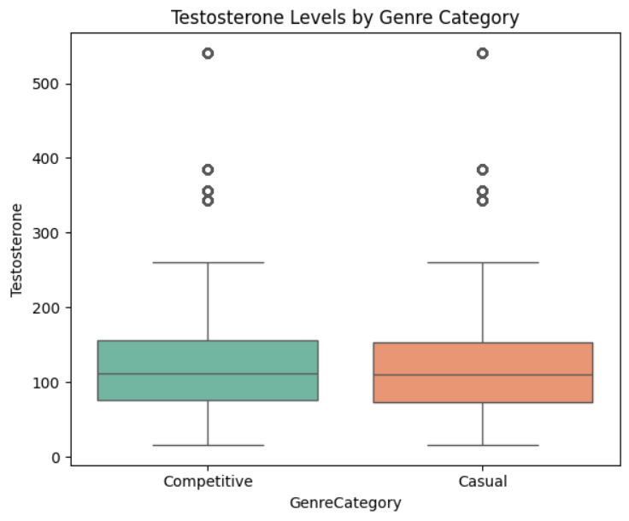
Testosterone Levels by Genre Category
🎯 Purpose: To explore how game type (Casual vs. Competitive) is related to testosterone levels.
📊 What the Chart Shows:
Boxplot compares testosterone distributions between two genre categories.
Green = Competitive games (e.g., FPS, sports, strategy)
Orange = Casual games (e.g., simulation, RPG)
💡 Key Insight:
Testosterone levels are slightly higher among players who prefer competitive games.
However, the overlap is considerable, suggesting only a mild association.

Slide 6
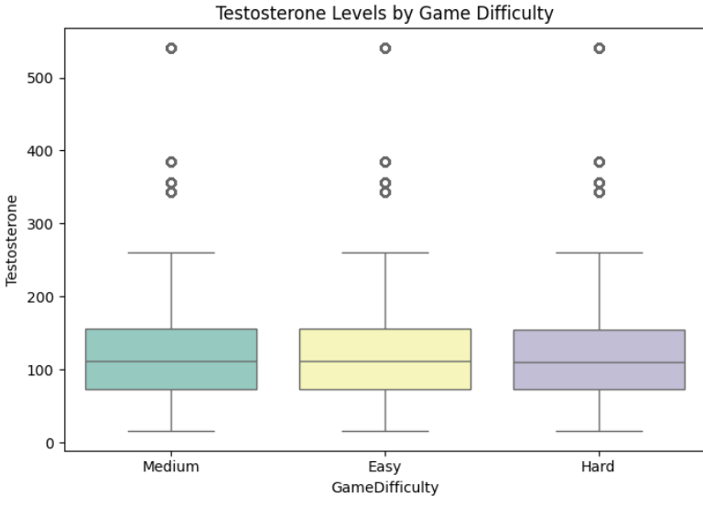
Testosterone Levels by Game Difficulty
🎯 Purpose: To investigate whether the perceived difficulty of games is related to testosterone levels.
📊 What the Chart Shows:
Boxplot displays testosterone distribution across Easy, Medium, and Hard game difficulty categories.
Each group shows range, median, and outliers of hormone levels.
💡 Key Insight:
Testosterone levels are visually similar across difficulty levels.
Slight variations exist, but no strong pattern is observed.
This suggests that game difficulty alone is not a key driver of hormonal variation.

Slide 7
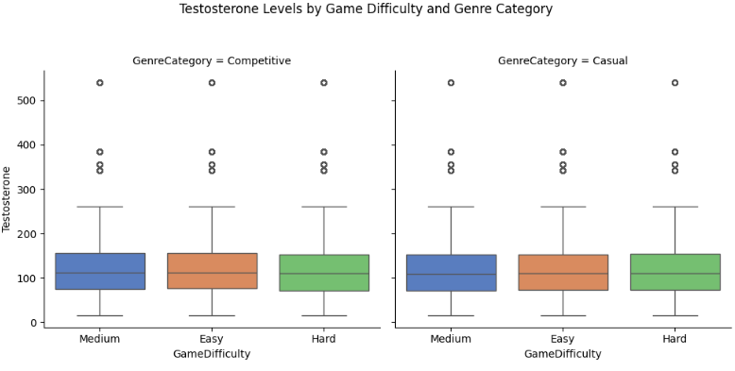
Testosterone by Game Difficulty & Genre Category
🎯 Purpose: To examine the combined effect of game difficulty and game genre on testosterone levels.
📊 What the Chart Shows:
Two panels show testosterone levels across Easy, Medium, and Hard games
Left = Competitive Games, Right = Casual Games
💡 Key Insight:
Testosterone levels are relatively stable across difficulty levels within each genre.
Slight differences exist, but no consistent or strong trend is visible.
This suggests that the interaction between difficulty and genre does not significantly influence testosterone.

Slide 8
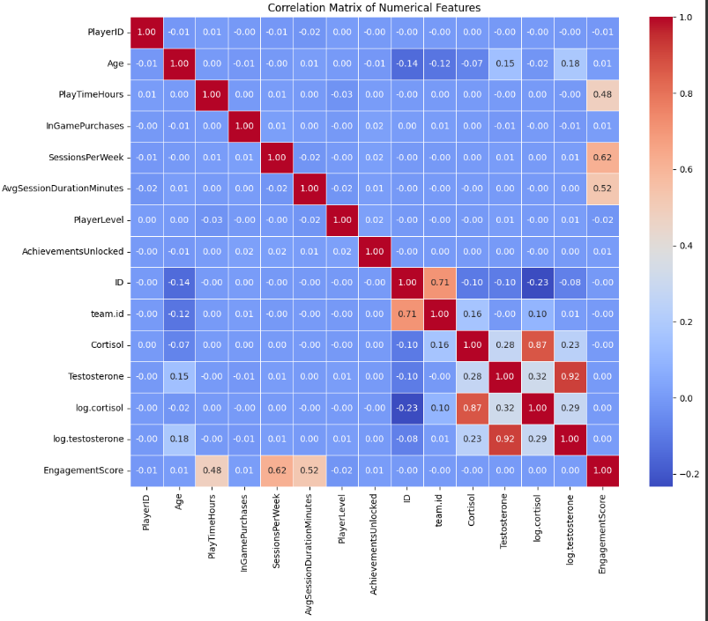
Correlation Matrix of Numerical Features
🎯 Purpose: To visualize linear relationships between numerical features, including gaming
behavior and hormone levels.
📊 What the Chart Shows:
Blue tones = weak or negative correlation
Red tones = strong positive correlation
Matrix compares features like PlayTime, Engagement, Cortisol, Testosterone
💡 Key Insights:
🔺 EngagementScore is moderately correlated with:
PlayTimeHours (r = 0.48)
SessionsPerWeek (r = 0.62)
AvgSessionDuration (r = 0.52)
🔺 Testosterone shows weak correlation with gaming features, but:
EngagementScore has a visible positive trend (r ≈ 0.29)
log.testosterone has strong correlation with raw testosterone (r = 0.92)
⚠️ Most gameplay features are not strongly correlated with cortisol or
testosterone directly, indicating the need for non-linear modeling.

Slide 9
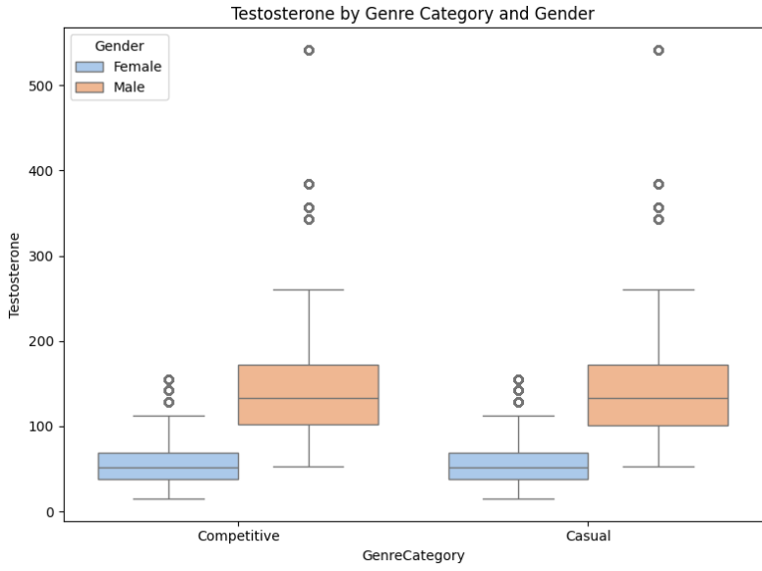
Testosterone by Genre Category and Gender
🎯 Purpose: To analyze how game preference relates to testosterone levels, separately for male and female participants.
📊 What the Chart Shows:
Boxplots compare testosterone levels across Competitive and Casual genres, grouped by gender.
Blue = Female, Orange = Male
💡 Key Insight:
Males consistently show higher testosterone than females across both genres.
Genre preference does not significantly alter hormone levels within genders.
Gender appears to be a stronger predictor than game category.

Slide 10
📍 K-Nearest Neighbors (KNN) Classification
🔍 Method:
Non-parametric, instance-based classifier
Predicts class based on similarity to k nearest neighbors
Ideal for smaller and structured datasets
⚙️ Implementation Steps:
Data preprocessing: one-hot encoding & standardization
Train/test split using train_test_split
Model training using KNeighborsClassifier(k=5)
🎯 Target Variable:
TestosteroneHigh → Binary: 1 (high), 0 (low)
📐 Features Used:
EngagementScore, SessionsPerWeek, PlayerLevel, GameDifficulty (encoded)

Slide 11
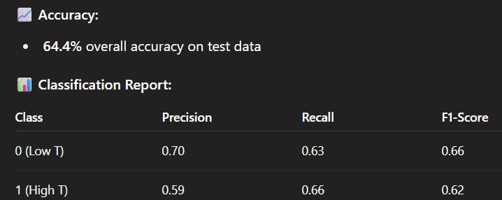
KNN Model Results & Performance
🔄 Macro Avg: Precision: 0.64 | Recall: 0.65 | F1: 0.64
📌 Prediction Example:
A user with EngagementScore=30, GameDifficulty=Medium, etc. → Predicted Class: 0 (Low Testosterone) → Probability: 100% certainty
🧠 Interpretation:
The model performs reasonably well, especially at identifying low-testosterone individuals.
Further tuning (e.g., feature selection, K optimization) may improve class 1 (high T) prediction.

Slide 12
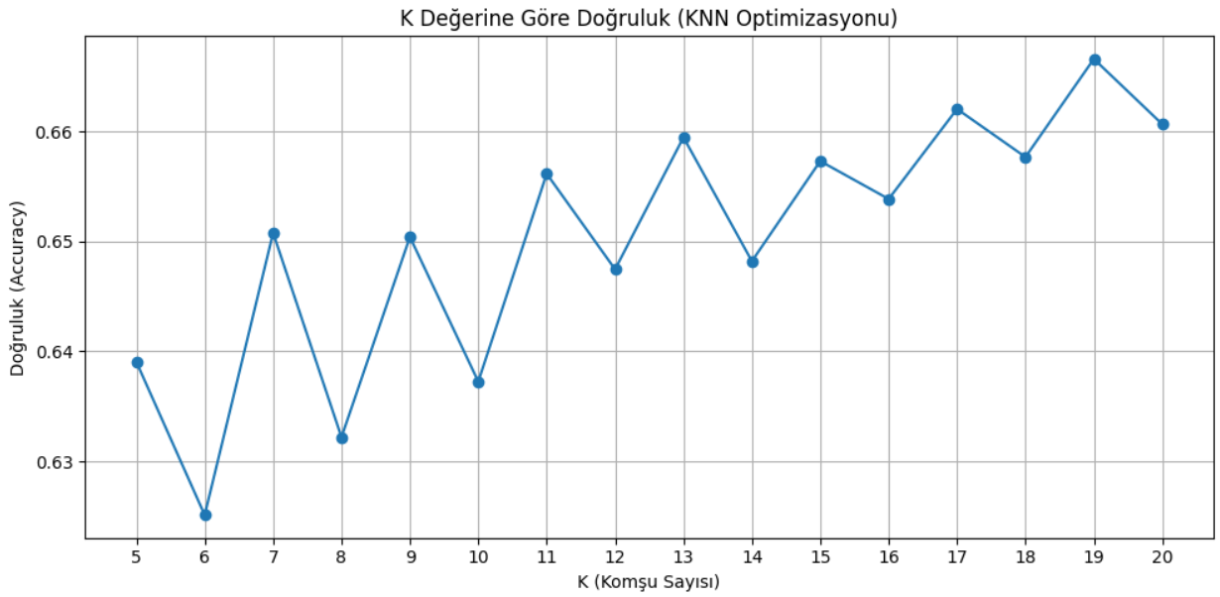
K Value Optimization in KNN
🎯 Purpose: To identify the optimal number of neighbors (k) for best
KNN model performance.
📊 What the Chart Shows:
X-axis: k values tested (from 5 to 20)
Y-axis: Classification accuracy
Peak performance at k = 19 with accuracy ≈ 66.6%
🔍 Key Observations:
Lower k values (e.g., 5–10) show higher fluctuation in accuracy
Mid to high values (13–20) exhibit more stable performance
k = 19 provided the best result in this experiment
💡 Conclusion: Choosing the right k is critical to KNN success. This result confirms that tuning hyperparameters improves predictive accuracy.

Slide 13
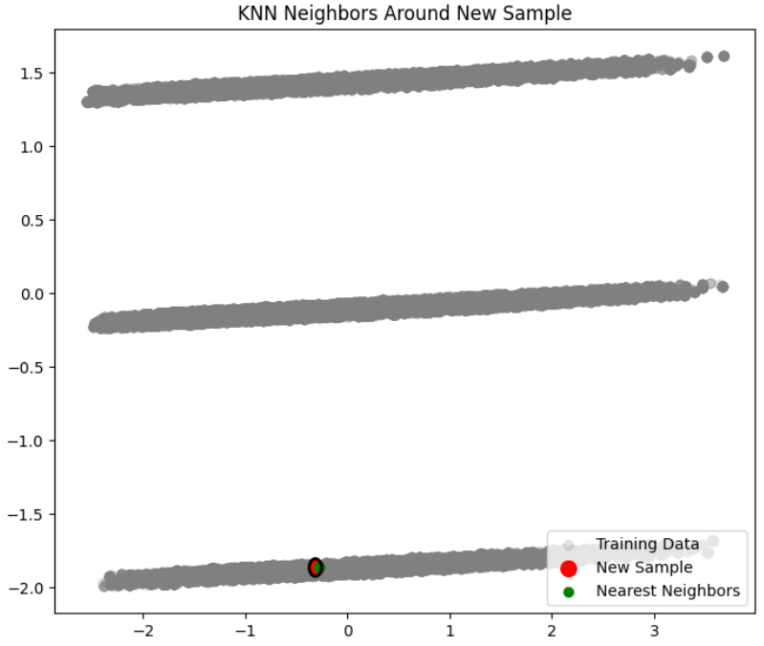
KNN Neighbors Around New Sample
🎯 Purpose: To visualize how the KNN algorithm classifies a new sample by identifying its nearest neighbors in the feature space.
📊 What the Chart Shows:
Gray dots = all training data points
Red dot = new input sample
Green dots = selected nearest neighbors (k=5)
💡 Key Insight:
The new sample is classified based on the majority label of its nearest neighbors.
In this case, neighbors around the red dot are tightly clustered, indicating a confident prediction.
This plot helps explain how local structure in data guides prediction in KNN.

Slide 14
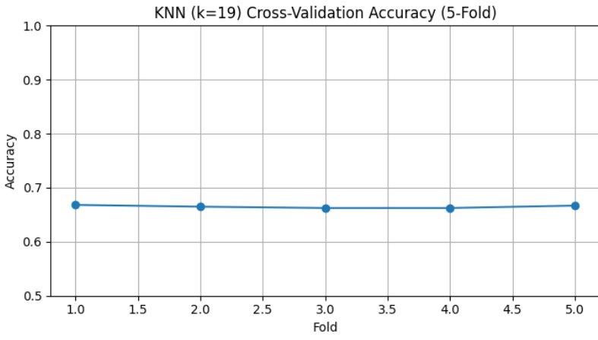
Cross-Validation Results for KNN (k=19)
🎯 Purpose: To evaluate how well the KNN model (with k = 19) generalizes to unseen data using 5-fold cross-validation.
📊 What the Chart Shows:
Accuracy results from 5 different data splits
All folds achieved scores between 66.2% and 66.8%
The average accuracy was 66.49%
💡 Key Insight:
The small variation between folds shows the model is stable
Indicates no overfitting to specific subsets
Confirms that k = 19 is a reliable choice for this classification task

Slide 15
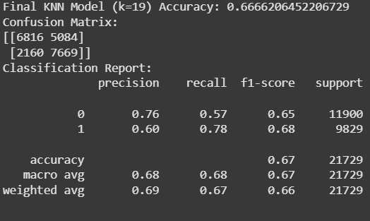
Stats of Models Summary

Slide 16
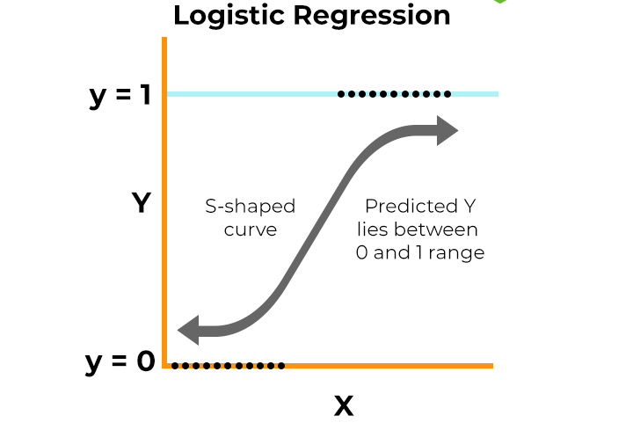
Logistic Regression Model Overview
🧠 Purpose: To test whether Engagement Score alone
can classify individuals into high vs low
testosterone groups using Logistic Regression.
⚙️ Implementation Steps:
Feature: EngagementScore
Target: TestosteroneHigh (binary)
Split: 80% training, 20% testing
Model: LogisticRegression()
🔄 Prediction:
Simple linear decision boundary
Applied on standardized, single-feature input

Slide 17
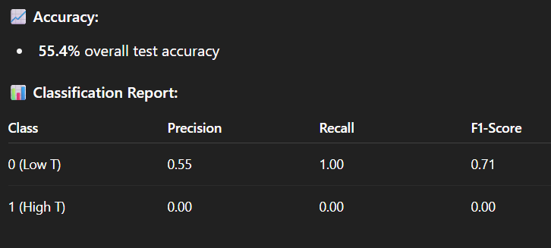
Logistic Regression Results & Performance
💡 Interpretation:
The model always predicts class 0 (Low Testosterone)
Completely fails to detect class 1 (High Testosterone)
Indicates Engagement Score alone is not a strong linear predictor
Suggests the need for multi-feature input or non-linear models

Slide 18
Logistic Regression with Enriched Features
🧠 Purpose: To re-train Logistic Regression using multiple behavioral features to improve classification performance.
📋 Features Used:
EngagementScore
SessionsPerWeek
PlayerLevel
One-hot encoded GameDifficulty
⚙️ Method:
Train/test split (80/20)
Model: LogisticRegression()
Binary target: TestosteroneHigh (0 = low, 1 = high)
🧪 Goal: To test if a richer feature set improves the model’s ability to predict high-testosterone individuals.

Slide 19
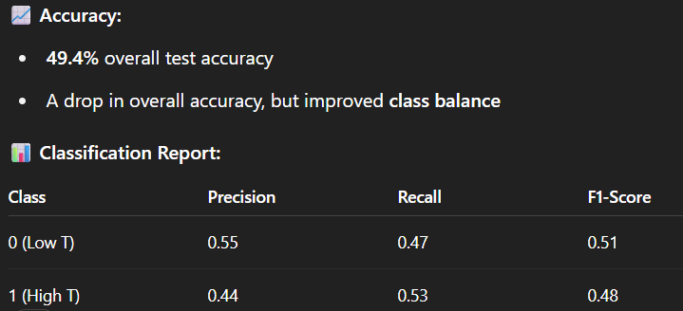
Updated Logistic Regression Results
🔍 Key Takeaways:
✅ Using a richer feature set, the model improved in classifying both low and high testosterone groups.
⚖️ Though overall accuracy dropped to ~49%, the recall for high-testosterone individuals improved to 0.53.
📈 This suggests the model began learning meaningful behavioral patterns linked to hormonal levels.
🧠 Features like Engagement Score, Game Difficulty, and Sessions Per Week may carry noisy but real signals.

Slide 20
Interpretation of Enhanced Logistic Regression
Key Takeaways:
✅ Using a richer feature set, the model improved in classifying both low and high testosterone groups.
⚖️ Though overall accuracy dropped to ~49%, the recall for high-testosterone individuals improved to 0.53.
📈 This suggests the model began learning meaningful behavioral patterns linked to hormonal levels.
🧠 Features like Engagement Score, Game Difficulty, and Sessions Per Week may carry noisy but real signals.

Slide 21
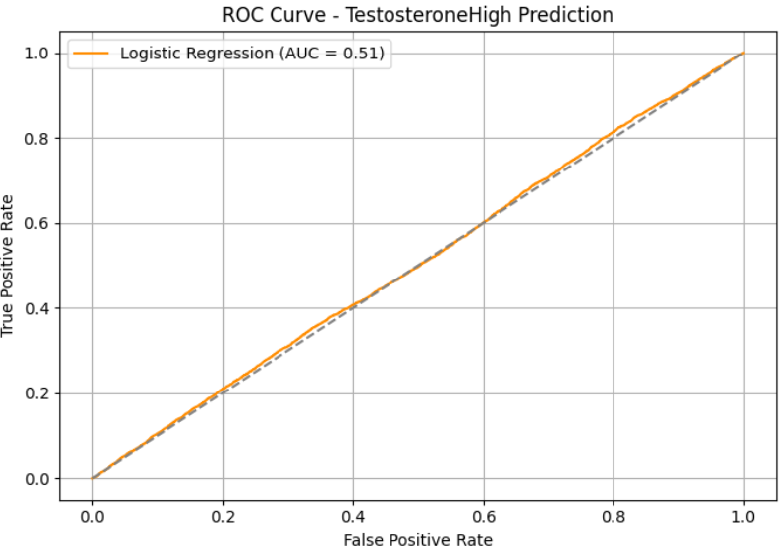
ROC Curve: Logistic Regression
🎯 Purpose: To evaluate the model’s ability to distinguish
between high and low testosterone classes
using the ROC-AUC metric.
📊 What the Chart Shows:
ROC curve for Logistic Regression on TestosteroneHigh
AUC = 0.51, which is only slightly better than random
guessing (0.50)
The curve nearly overlaps with the diagonal line (random baseline)
💡 Key Interpretation:
While the model could predict both classes, its discrimination
power is weak
Suggests that:
The relationship between features and testosterone may
be nonlinear, or
Behavioral signals may be too noisy or weak for a linear
model
Confirms the need for richer models or feature engineering

Slide 22
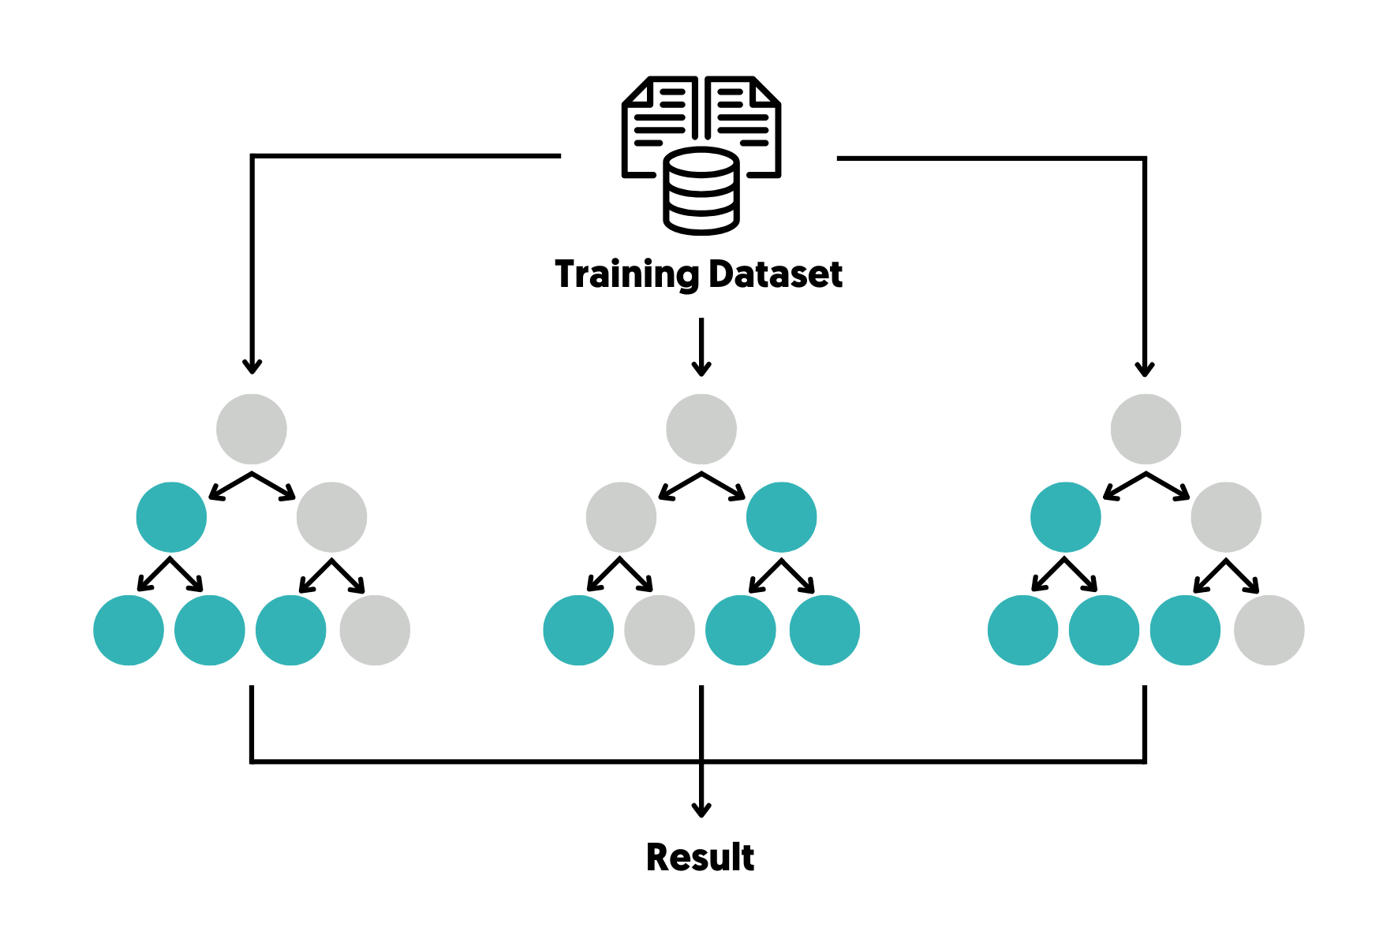
Decision Tree Model Overview
🌳 Purpose: To test a simple tree-based model for predicting high vs low testosterone using behavioral features.
⚙️ Implementation Details:
Model: DecisionTreeClassifier(max_depth=4)
Features used: Same enriched behavioral set as in logistic regression
Training/test split: 80/20
Target: TestosteroneHigh (binary classification)
🔍 Why Decision Tree?
Provides interpretable decision rules
Can model non-linear relationships

Slide 23
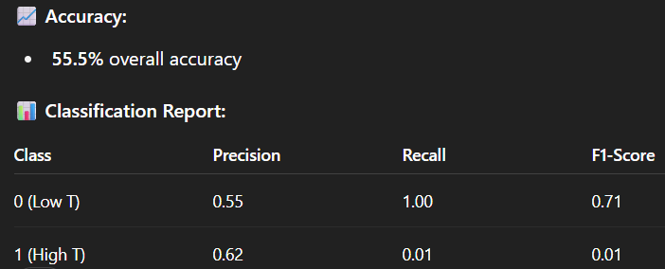
Decision Tree Results & Interpretation
💡 Key Takeaways:
The model memorized class 0, predicting high recall for low testosterone
Despite some precision for class 1, recall is very poor (0.01)
Indicates severe class imbalance sensitivity and underfitting with shallow depth

Slide 24
Random Forest Classifier Overview
🌲 Purpose: To build a robust and non-linear model that can handle
imbalanced data and capture complex feature interactions.
⚙️ Implementation Details:
Model: RandomForestClassifier(n_estimators=100, class_
weight='balanced')
Features: EngagementScore, SessionsPerWeek,
GameDifficulty, PlayerLevel, etc.
Train/test split: 80/20
Target: TestosteroneHigh (binary)
📌 Why Random Forest?
Handles non-linearity and noisy features well
Balances bias-variance tradeoff
Automatically reveals feature importance

Slide 25
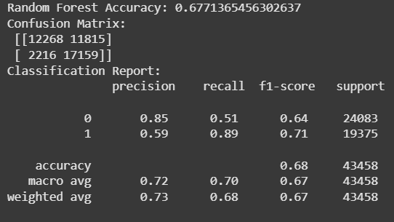
Random Forest Results & Interpretation
💡 Key Insights:
Best overall class balance across precision, recall, and F1
High recall (0.89) for high-testosterone class = effective detection
High precision (0.85) for low-testosterone = confident negative predictions
Most reliable candidate for further interpretability (e.g., feature importance) or deployment

Slide 26
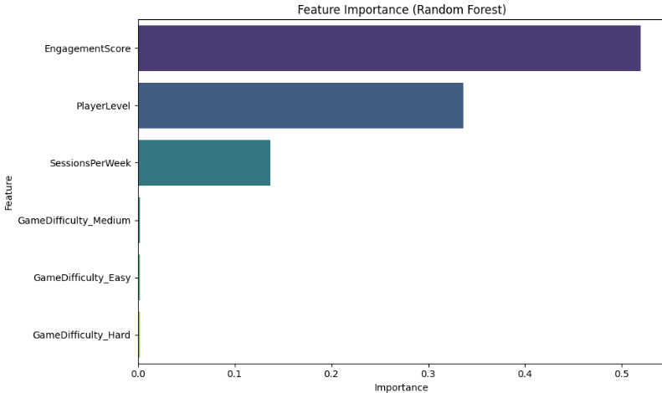
Feature Importance (Random Forest)
🎯 Purpose: To identify which behavioral features contributed most to predicting high testosterone levels in the Random Forest model.
📊 What the Chart Shows:
EngagementScore is the most important feature → Responsible for over 50% of decision impact
PlayerLevel and SessionsPerWeek follow, with meaningful contributions
GameDifficulty (Easy/Medium/Hard) has negligible importance
💡 Key Interpretation:
Behavioral intensity (captured via EngagementScore) is the strongest signal
Difficulty level of games does not significantly relate to hormonal profile
Supports the idea that how often and how long someone plays matters more than what they play

Slide 27
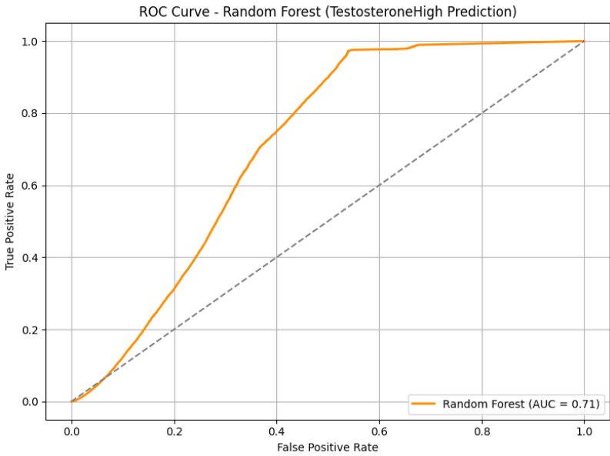
ROC Curve: Random Forest Model
🎯 Purpose: To evaluate the discrimination capability of the Random Forest model using the ROC-AUC metric.
📊 What the Chart Shows:
ROC curve for predicting TestosteroneHigh
AUC = 0.71, significantly higher than random baseline (AUC = 0.5)
Curve rises well above diagonal, indicating effective class separation
💡 Key Interpretation:
AUC of 0.71 reflects a strong ability to distinguish between low and high testosterone groups
Supports prior findings from:
✅ Classification report (high recall for Class 1)
✅ Feature importance (EngagementScore + PlayerLevel = key drivers)
Confirms Random Forest is the most effective model tested

Slide 28
XGBoost Classifier Overview
⚙️ Model:
XGBoostClassifier() with default or tuned settings
Used same behavioral features as other models
Train/test split (80/20)
Target: TestosteroneHigh
🧠 Why XGBoost?
Boosted ensemble of decision trees
Handles non-linearity and noise well
Great for imbalanced and structured data

Slide 29
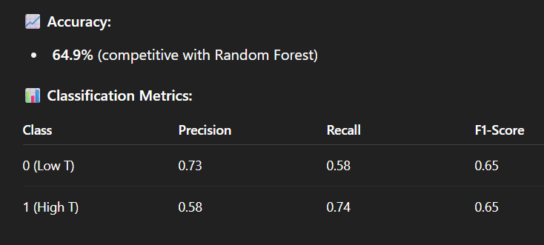
XGBoost Results & Interpretation
💡 Key Takeaways:
High recall for Class 1 (0.74) = strong detection of high-testosterone individuals
Consistent F1-score (0.65) across both classes
Shows superior class balance over Decision Tree or Logistic Regression
Captures nonlinear interactions between features like EngagementScore and PlayerLevel

Slide 30
ROC Curve: XGBoost Model
🎯 Purpose: To assess how well the XGBoost model distinguishes between low and high testosterone classes using ROC-AUC.
📊 What the Chart Shows:
AUC = 0.70, indicating a strong separation ability
Curve rises clearly above the diagonal (random baseline)
Demonstrates reliable prediction for high-testosterone individuals
💡 Interpretation:
XGBoost outperforms Logistic Regression and Decision Tree in class discrimination
Captures nonlinear patterns from features like EngagementScore and PlayerLevel
Reinforces its robustness and generalizability for hormonal trait prediction

Slide 31
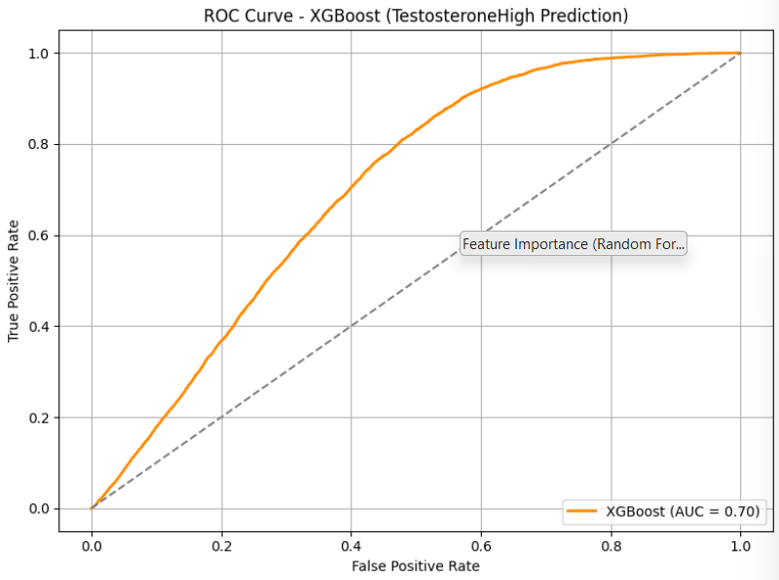
Cross-Validation Results (XGBoost)
🔎 Purpose: To evaluate the stability and generalizability of XGBoost across different data splits using 5-fold cross-validation.
📊 Key Findings:
Average cross-validation accuracy: ~50.7%
Fold scores ranged from ~0.49 to 0.51
Substantially lower than test set accuracy (~65%)
💡 Interpretation:
Indicates potential overfitting or data split sensitivity
Model may be performing well on one specific split, but lacks robustness
Suggests need for:
Better regularization
Enhanced hyperparameter tuning
🧠 Conclusion: While XGBoost offers strong single-run accuracy and AUC = 0.70, its low cross-validation performance underscores the need for improvements in generalization to be deployment-ready.

Slide 32
Insights & Final Evaluation
📌 Summary of Models:
🔶 XGBoost achieved solid accuracy (0.65) and AUC (0.70) → Best overall model with balanced performance
🌲 Random Forest had the highest accuracy (0.68) and recall (0.89) → Strong in sensitivity, great for detecting high-testosterone individuals
📍 KNN showed moderate accuracy (0.64) but lower AUC (~0.66) → Affected by class imbalance and feature scale sensitivity
📉 Logistic Regression struggled with imbalanced data → Only effective with richer feature sets; poor initial performance

Slide 33
Insights & Final Evaluation
While all models contributed insights, Random Forest emerged as the most robust and interpretable classifier for predicting testosterone levels based on behavioral data. Its balanced recall, accuracy, and feature importance clarity make it a reliable candidate for deployment or further research.

Slide 34
THANKS
Haşim Büyükçelik 32689

